Slide 1






The Power of Language
Alan Edelman

Slide 2
The Power of Language for performance
Alan Edelman

Slide 3
The Power of Language for productivity
Alan Edelman

Slide 4
The Power of Language for impact
Alan Edelman

Slide 5
The Power of Language for abstraction
Alan Edelman

Slide 6
The Power of Language for community building
Alan Edelman

Slide 7
The Power of Language for code reuse
Alan Edelman

Slide 8
The Power of Language to engage students
Alan Edelman

Slide 9
The Power of Language for HPC!
Alan Edelman

Slide 10
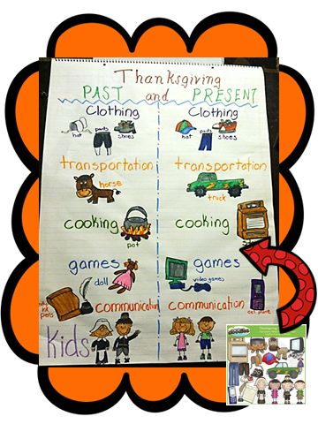
Thanksgiving Past & Present
2nd grade social studies:

Slide 11
Thanksgiving Past & Present
The week before

Slide 12


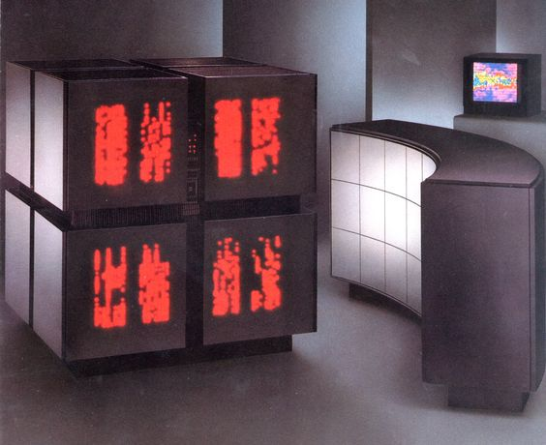
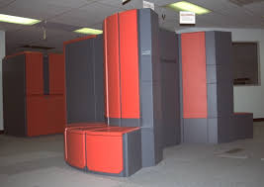
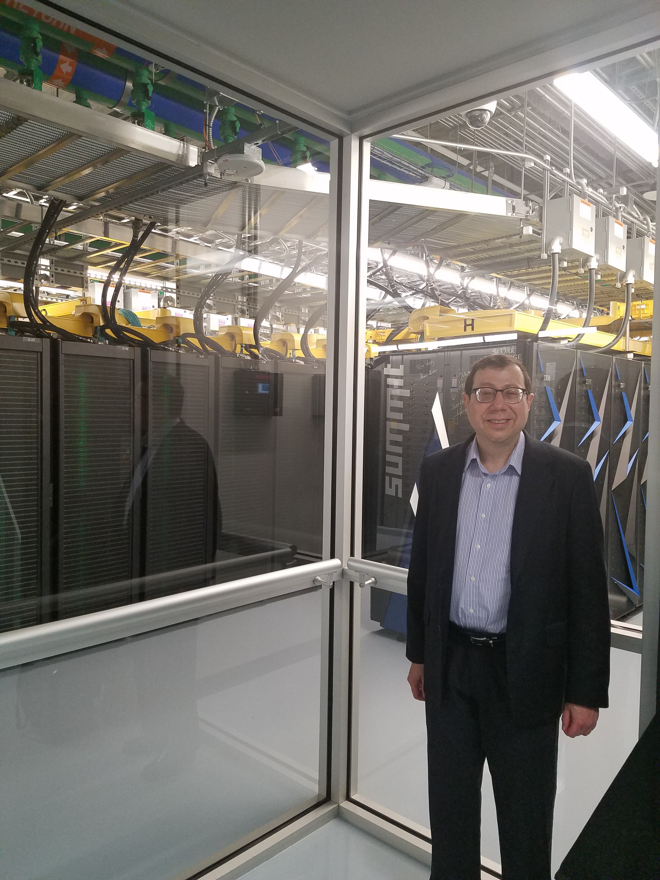
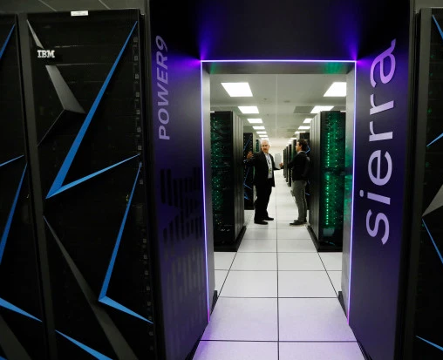
Thanksgiving Past & Present
The week before
Key Metric: Performance
Key Metric: Impact

Slide 13
Thanksgiving Past & Present
The week before
Key Metric: Performance
Users report results
Key Metric: Impact
Reproducible Science

Slide 14
Thanksgiving Past & Present
The week before
Key Metric: Performance
Users report results
Composability: who cares?
Key Metric: Impact
Reproducible Science
Composability: everyone needs

Slide 15
Thanksgiving Past & Present
The week before
Key Metric: Performance
Users report results
Composability: who cares?
Portability discussed
Key Metric: Impact
Reproducible Science
Composability: everyone needs
Heterogeneous Portability a must

Slide 16
Thanksgiving Past & Present
The week before
Key Metric: Performance
Users report results
Composability: who cares?
Portability discussed
Message Passing with PVM
Key Metric: Impact
Reproducible Science
Composability: everyone needs
Heterogeneous Portability a must
MPI showing signs of age

Slide 17
Thanksgiving Past & Present
The week before
Key Metric: Performance
Users report results
Composability: who cares?
Portability discussed
Message Passing with PVM
Small younger community
Key Metric: Impact
Reproducible Science
Composability: everyone needs
Heterogeneous Portability a must
MPI showing signs of age
Students have many competing choices

Slide 18
Thanksgiving Past & Present
The week before
Key Metric: Performance
Users report results
Composability: who cares?
Portability discussed
Message Passing with PVM
Small younger community
Some industrial connections
Key Metric: Impact
Reproducible Science
Composability: everyone needs
Heterogeneous Portability a must
MPI showing signs of age
Students have many competing choices
Easy to imagine way more industrial connections

Slide 19
Thanksgiving Past & Present
The week before
Key Metric: Performance
Users report results
Composability: who cares?
Portability discussed
Message Passing with PVM
Small younger community
Some industrial connections
Key Metric: Impact
Reproducible Science
Composability: everyone needs
Heterogeneous Portability a must
MPI showing signs of age
Students have many competing choices
Easy to imagine way more industrial connections
Workflow for success:
roll up sleeves &performance engineer

Slide 20
Thanksgiving Past & Present
The week before
Key Metric: Performance
Users report results
Composability: who cares?
Portability discussed
Message Passing with PVM
Small younger community
Some industrial connections
Key Metric: Impact
Reproducible Science
Composability: everyone needs
Heterogeneous Portability a must
MPI showing signs of age
Students have many competing choices
Easy to imagine way more industrial connections
Workflow for success:
roll up sleeves &performance engineer
Evolution of Workflow for success:
libraries
SDK's
DSL's
High-level languages

Slide 21
Thanksgiving Past & Present
The week before
Key Metric: Performance
Users report results
Composability: who cares?
Portability discussed
Message Passing with PVM
Small younger community
Some industrial connections
Key Metric: Impact
Reproducible Science
Composability: everyone needs
Heterogeneous Portability a must
MPI showing signs of age
Students have many competing choices
Easy to imagine way more industrial connections
Today’s Subject
Workflow for success:
roll up sleeves &performance engineer
Evolution of Workflow for success:
libraries
SDK's
DSL's
High-level languages

Slide 22
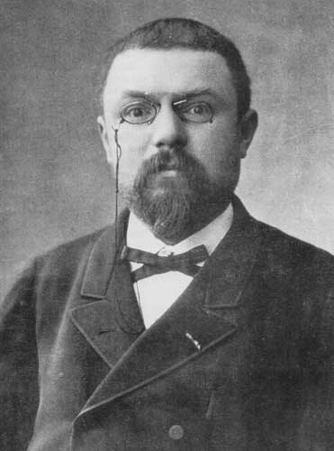
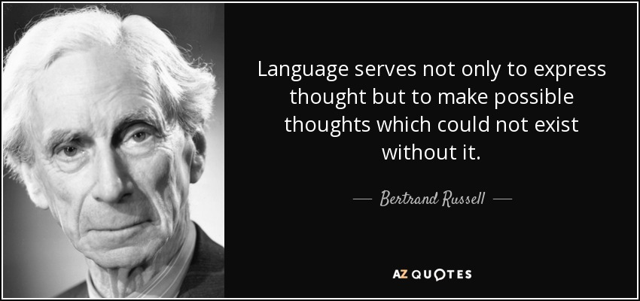
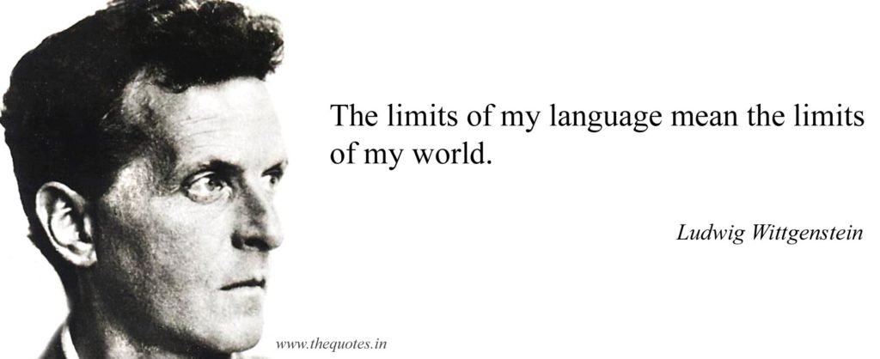

Historical Precedent: Philosophers & Mathematicians
When language has been well chosen,
one is astonished... (in mathematics
what’s possible…)
Henri Poincaré
Language is how we express our Computations
CS Language is applied psychology
we can coax performance…
Valentin Churavy
Graduate Student @ MIT

Slide 23
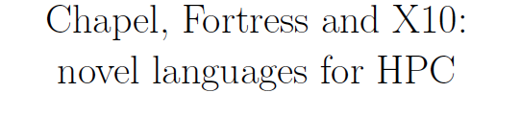
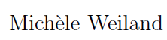
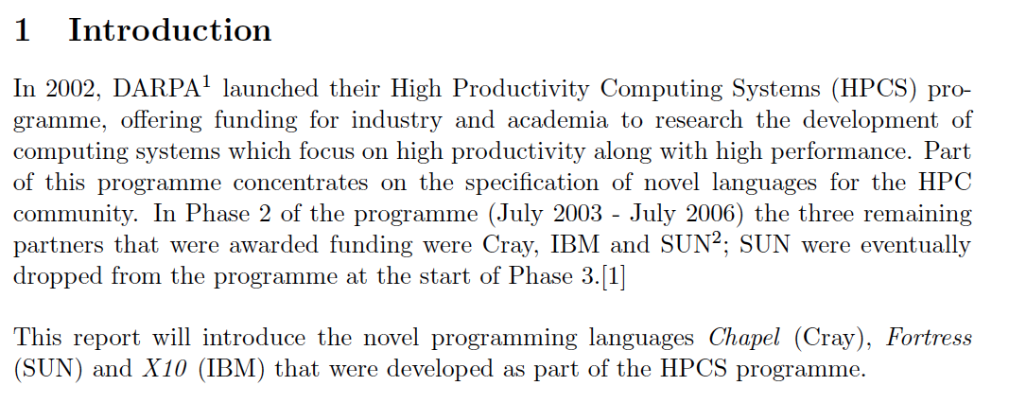
What did we miss 15 years ago?

Slide 24
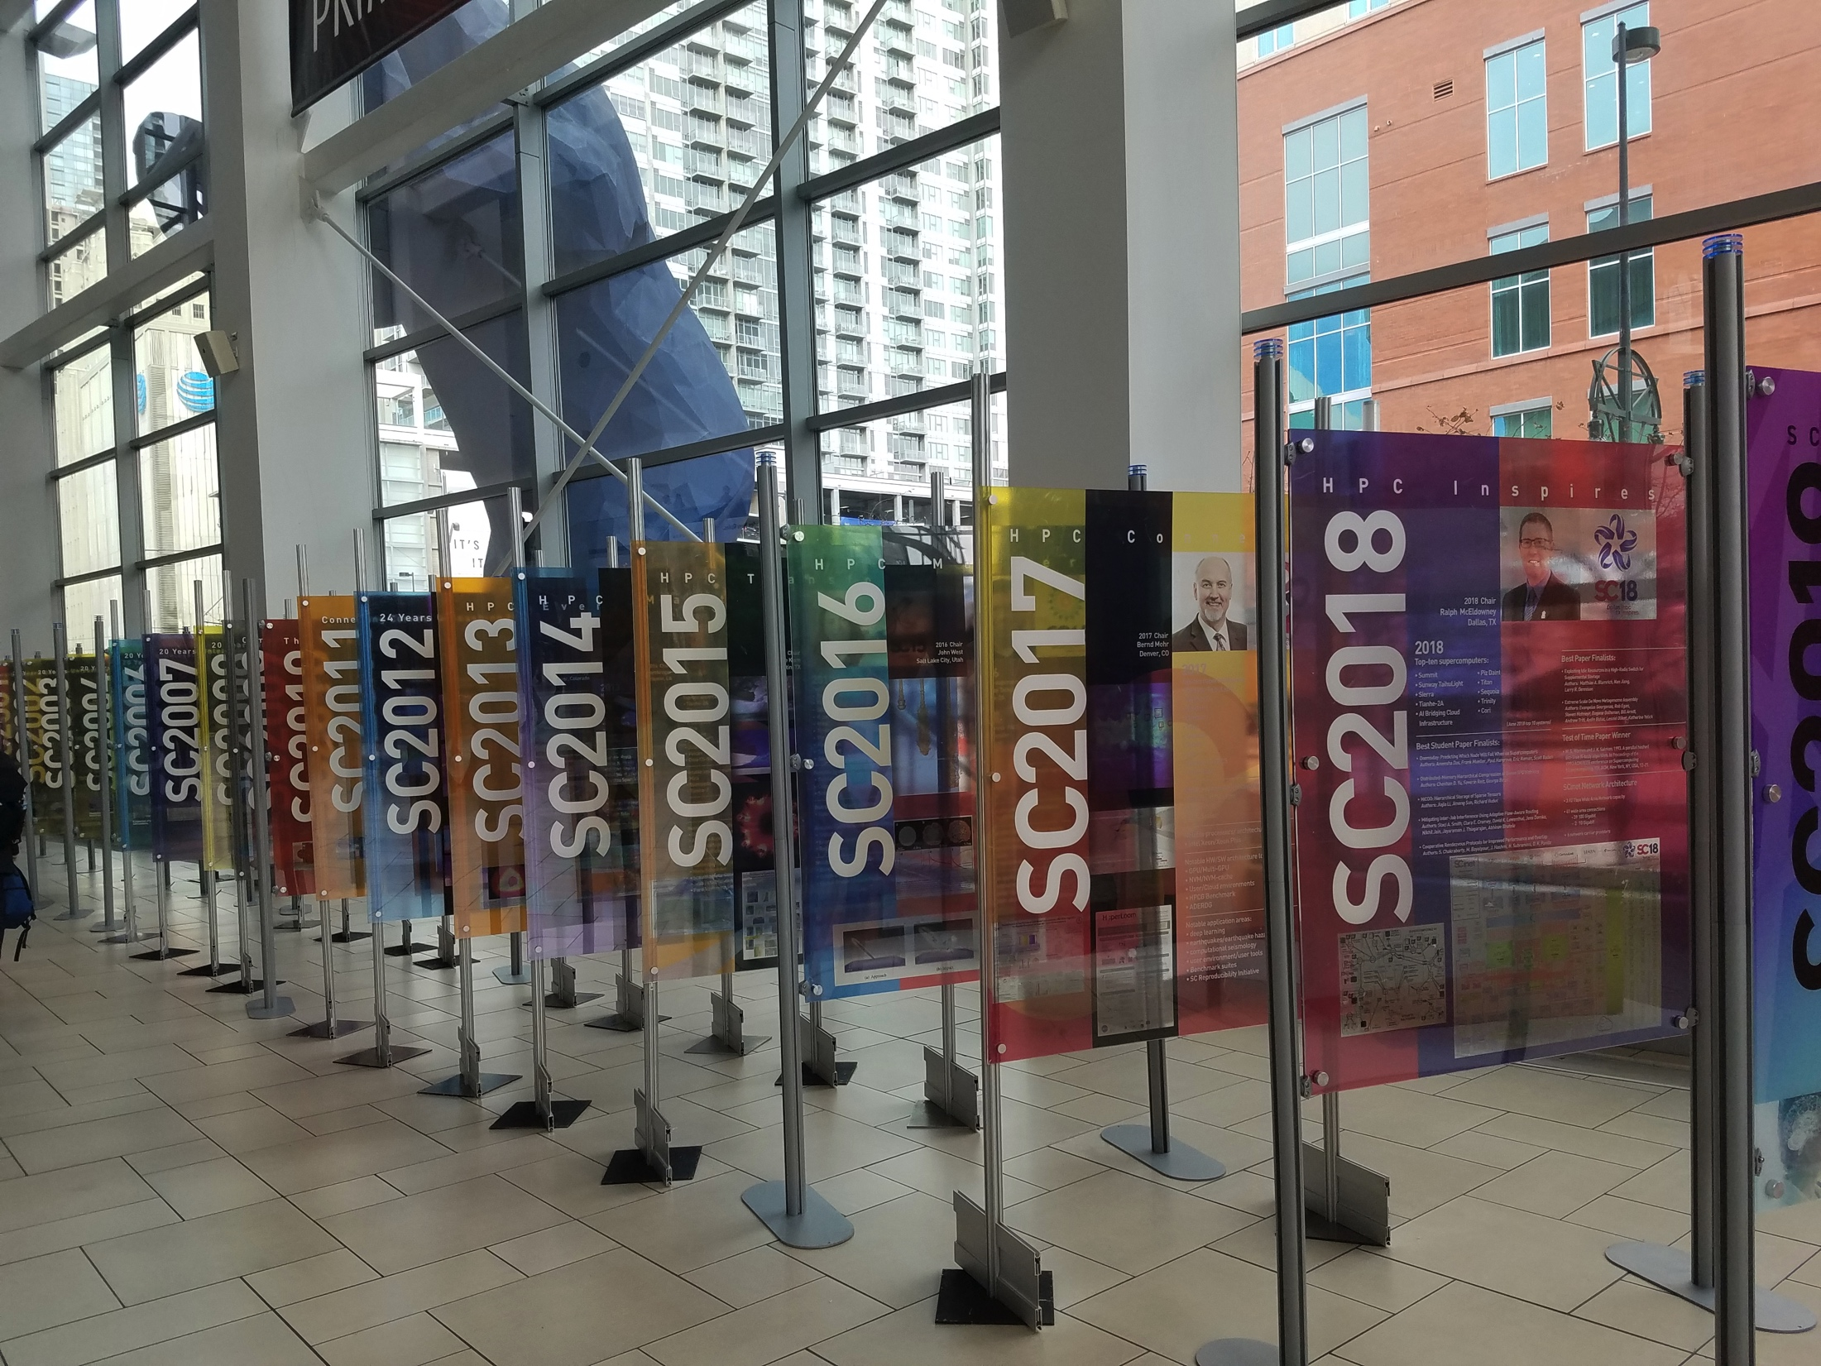
Something seems to have gone wrong!
The dark decade
1988
Programming Languages (x2005)
2010
2019

Slide 25
What did we miss 15 years ago?
A multidisciplinary user base for high productivity & high performance

Slide 26
What did we miss 15 years ago?
A multidisciplinary user base for high productivity & high performance
multiple dispatch
static + dynamic
type specialization
…

Slide 27

What did we miss 15 years ago?
A multidisciplinary user base for high productivity & high performance
See julialang.org/learning

Slide 28
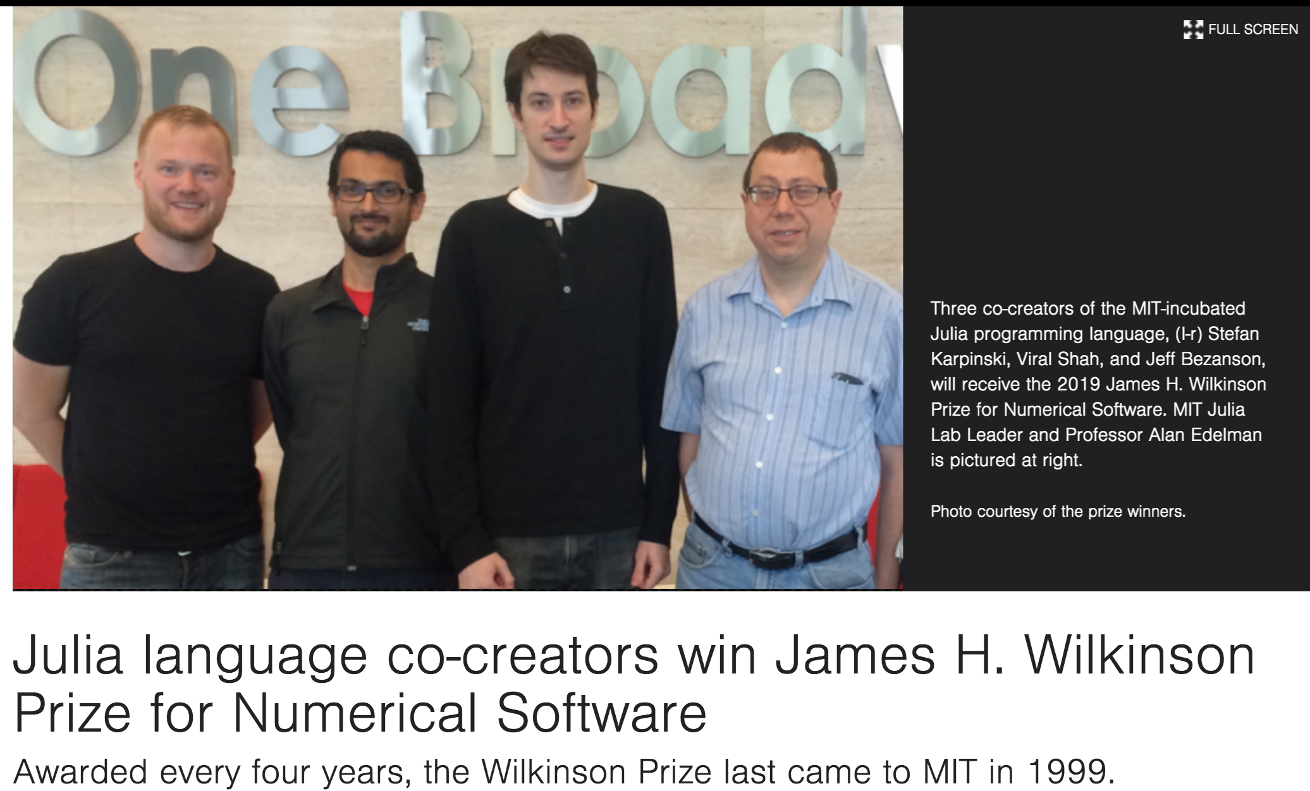
What did we miss 15 years ago?
A multidisciplinary user base for high productivity & high performance
multiple dispatch
static + dynamic
type specialization
…
We knew the right user base starts serial and takes 10 years to mature.

Slide 29
What did we miss 15 years ago?
A multidisciplinary user base for high productivity & high performance
multiple dispatch
static + dynamic
type specialization
…
“Patience is a virtue.”
We knew the right user base starts serial and takes 10 years to mature.

Slide 30
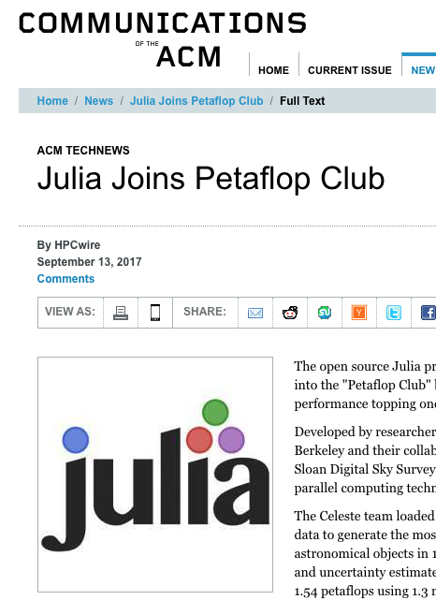



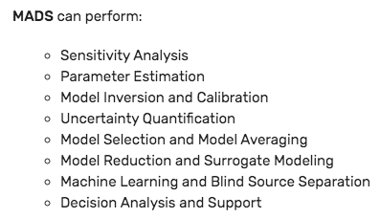
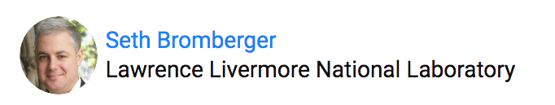

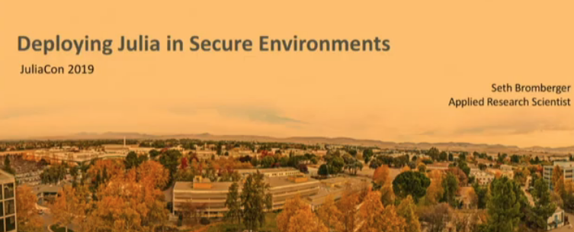
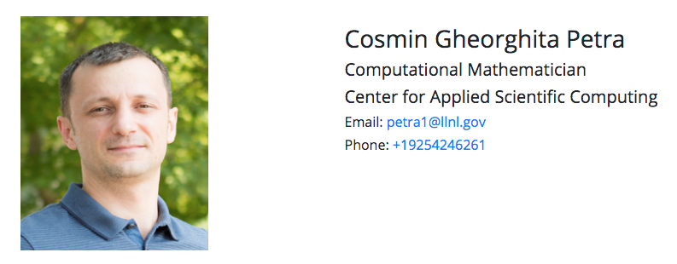
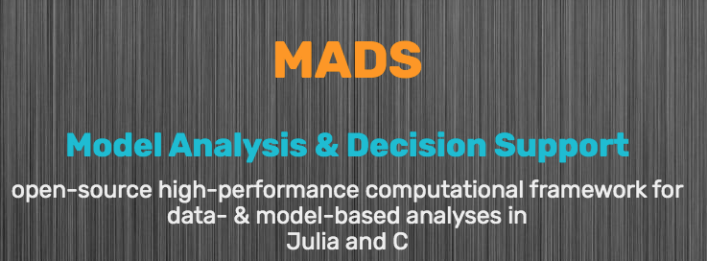
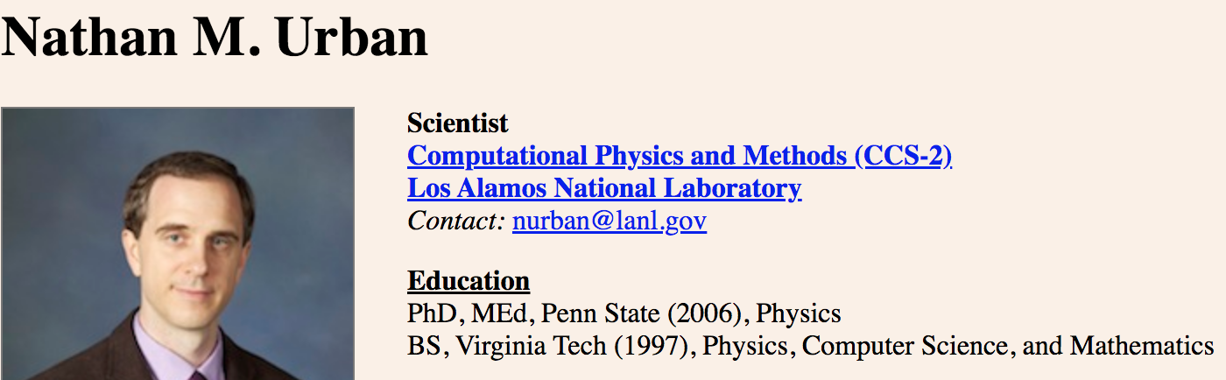

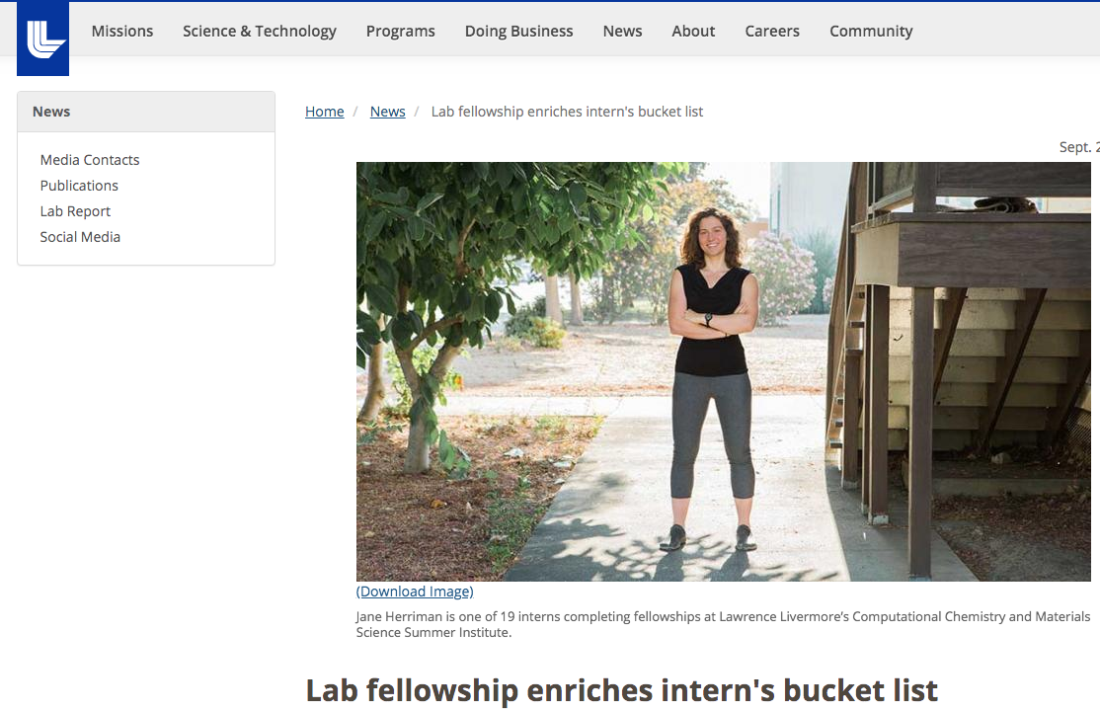
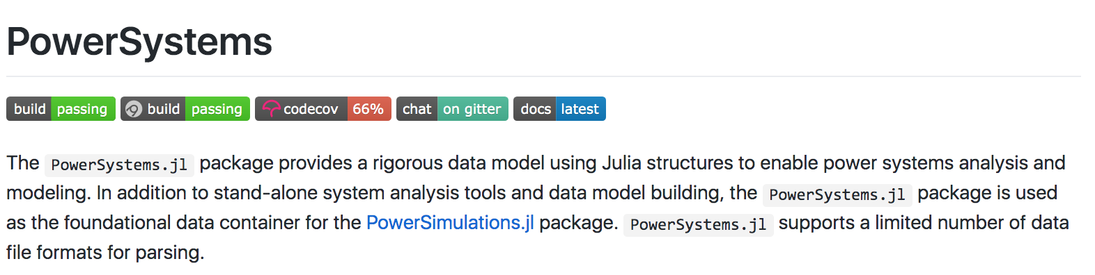
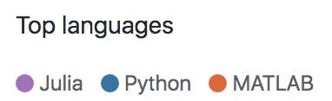

Julia at National Labs

Slide 31
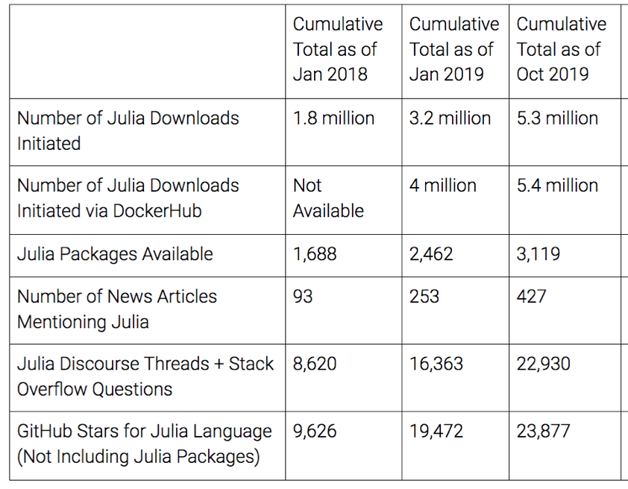
Julia at National Labs

Slide 32
Demo!

Slide 33
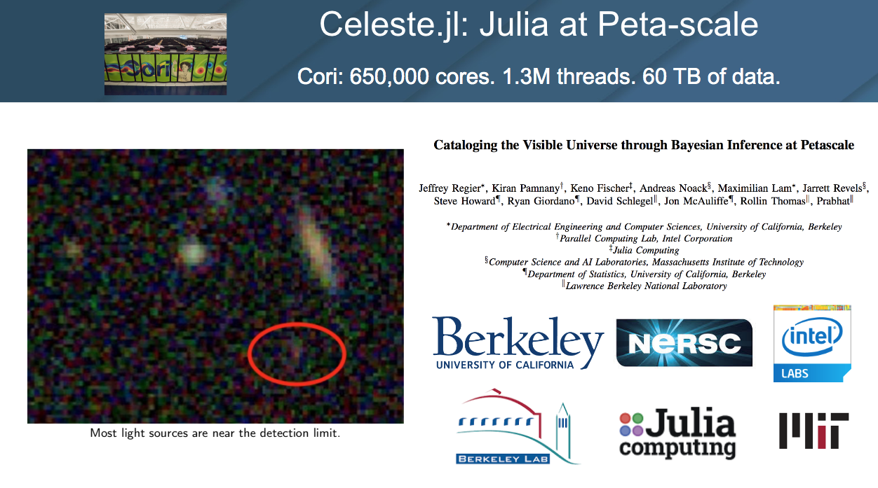

Slide 34
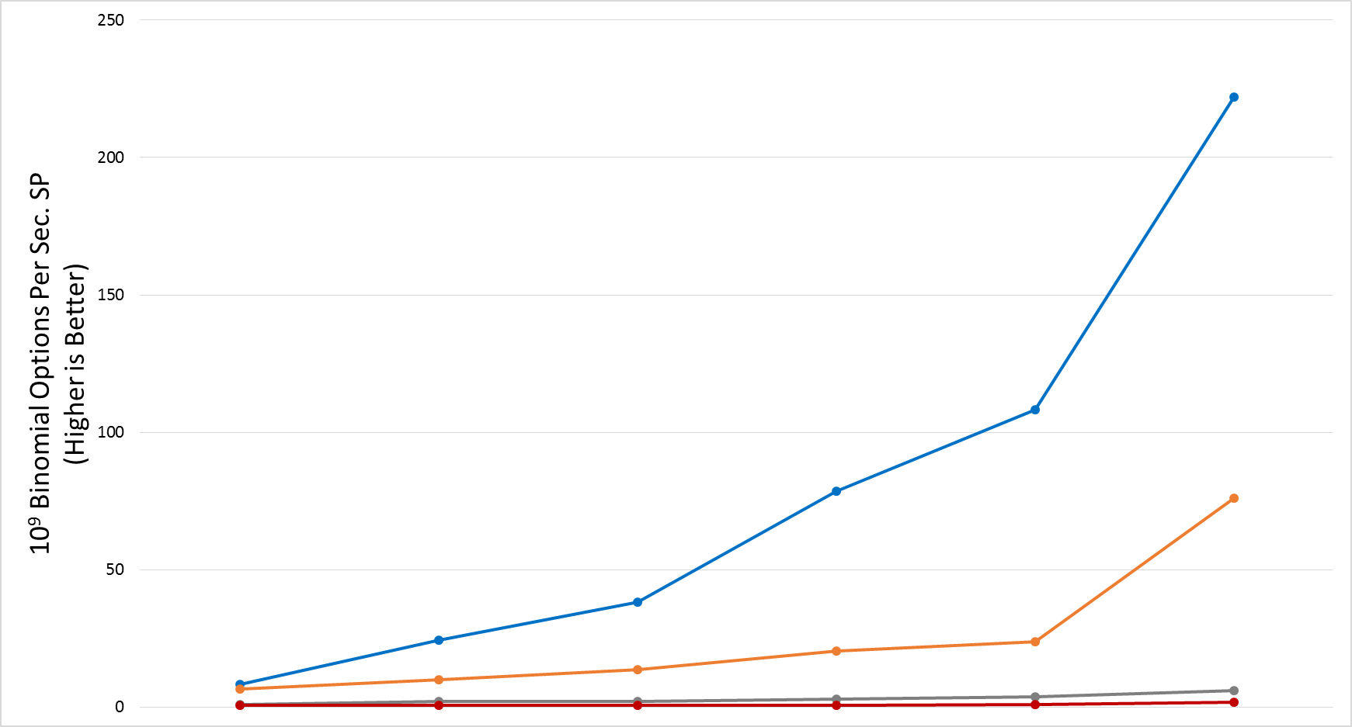
Julia @ Intel (Thanks Intel!) Vectorize & Thread or Performance Dies Threaded + Vectorized can be Much Faster Together than Either Alone
‘Automatic’ Vectorization is Not Enough Explicit pragmas and optimization are often required
Vectorized
& Threaded
200
150
100
50
0
130x
Threaded
Vectorized
Serial
2010
Intel® Xeon™ Processor X5680
formerly codenamed Westmere
2012
Intel® Xeon™
Processor E5-2600 formerly code-named Sandy Bridge
2013
Intel® Xeon™ Processor E5-2600 v2 formerly code-named Ivy Bridge
2014
Intel® Xeon™ Processor E5-2600 v3 formerly codenamed Haswell
2016
Intel® Xeon™ Processor E5-2600 v4 formerly code-named Broadwell
2017
Intel® Xeon® Platinum Processor 81xx formerly codenamed Skylake Server
Benchmark: Binomial Options Pricing Model https://software.intel.com/en-us/articles/binomial-options-pricing-model-code-for-intel-xeon-phi-coprocessor
Performance results are based on testing as of August 2017 and may not reflect all publicly available security updates. See configuration disclosure for details. No product can be absolutely secure.. For more complete information about performance and benchmark results, visit www.intel.com/benchmarks. See Vectorize & Thread or Performance Dies Configurations for 2010-2016 Benchmarks in Backup. Benchmarks source: Intel Corporation.
Intel's compilers may or may not optimize to the same degree for non-Intel microprocessors for optimizations that are not unique to Intel microprocessors. These optimizations include SSE2, SSE3, & SSSE3 instruction sets & other optimizations. Intel does not guarantee the availability, functionality, or effectiveness of any optimization on microprocessors not manufactured by Intel. Microprocessor-dependent optimizations in this product are intended for use with Intel microprocessors. Certain optimizations not specific to Intel microarchitecture are reserved for Intel microprocessors. Please refer to the applicable product User and Reference Guides for more information regarding the specific instruction sets covered by this notice. Notice Revision #20110804
34

Slide 35

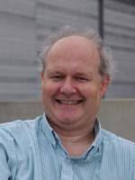
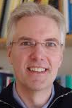
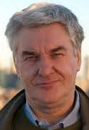

MIT News: New climate model to be built from the ground up
December 12, 2018
To take advantage of new computer architectures, languages, and machine learning techniques, the team has partnered with Alan Edelman‘s group in CSAIL at MIT, who will help write the new generation climate model in the Julia computing language developed by the group. This will enable the MIT team to target GPUs, CPUs, and evolving computer architectures within one code base.
Tapio Schneider Chris Hill Raffaele Ferrari John Marshall

Slide 36
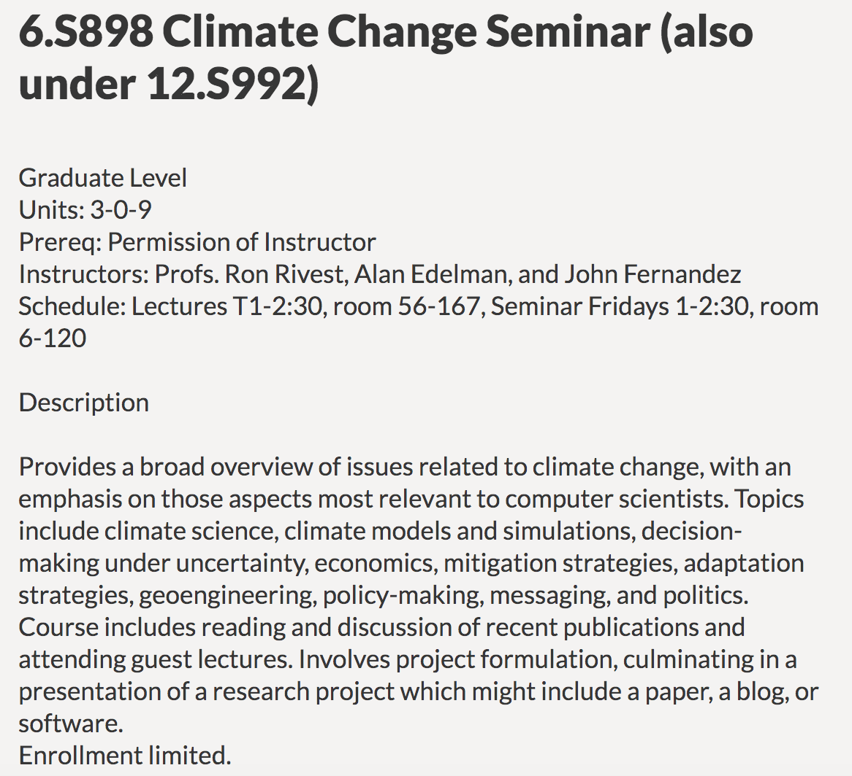
MIT News: New climate model to be built from the ground up
December 12, 2018
To take advantage of new computer architectures, languages, and machine learning techniques, the team has partnered with Alan Edelman‘s group in CSAIL at MIT, who will help write the new generation climate model in the Julia computing language developed by the group. This will enable the MIT team to target GPUs, CPUs, and evolving computer architectures within one code base.
New EECS Class @ MIT

Slide 37
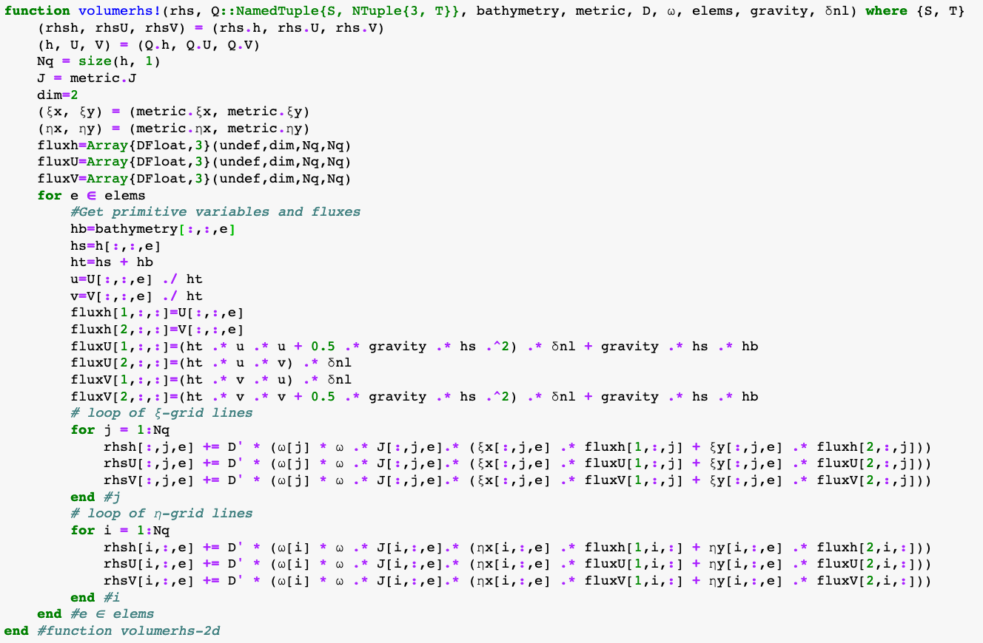
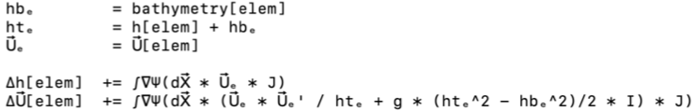
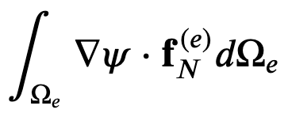
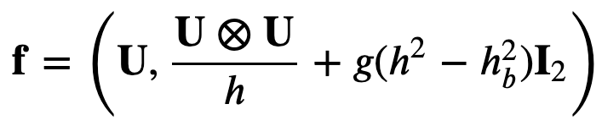
Code is the “New” Math
You don’t “code” the “math,” “code” is the “math”

Slide 38

http://worrydream.com/ClimateChange/
Simple, contributing to Julia!

Slide 39
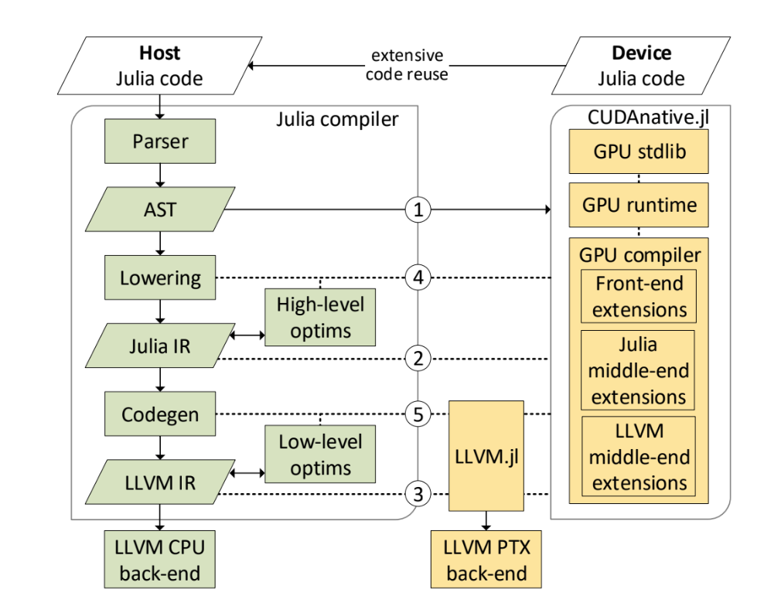
Abstraction
Julia on GPUs
Not just CUDA in Julia, but actually Julia running on GPUs:
Error handling
Data Structures — Arrays, Views, etc not pointers
Future work: Garbage Collection on GPU

Slide 40

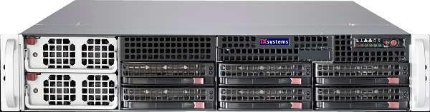
Software performance engineering
Think,
code,
How do we reduce the human effort required to achieve parallel scalability in large and complex software systems?
run, run, run…
How do we make exascalability not exahard?
…to test and measure many different implementations
Slide supplied by Charles Leierson

Slide 41

Software performance engineering
Think,
code,
How do we reduce the human effort required to achieve parallel scalability in large and complex software systems?
run, run, run…
How do we make exascalability not exahard?
…to test and measure many different implementations

Slide 42
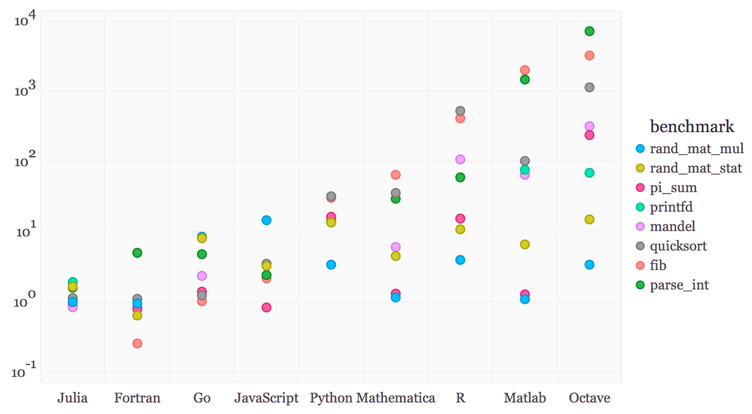
Julia’s active areas
Differentiable Programming
HPC becoming Scientific Machine Learning
Neural ODE’s
Composable through Julia Stack
Composable through legacy code
High Performance
Productivity
Portability (Heterogeneity)
From a high level language
“Some thought it couldn’t be done”
Say “what you want to compute”
not how you want to compute it
Give Legacy MPI Code a new life
A new generation of users

Slide 43
is a high level parallel computing language
will solve the great HPC language
Problem ….

Slide 44
Parallel Research Areas
Unified SPMD programming model
where a function can run at scale from a single core all the way to the full system without any code modifications.
Task based parallel code
automatically distribute to cpus and gpus
A dynamic scheduler where a single abstraction – spawn
- can launch computations on different computational elements throughout the system.
Mechanisms to build distributed data structures,
and to reason about memory locality
Interface with Tapir (Leiserson, Schardl)
… and some good old fashioned performance engineering

Slide 45
Please participate!
discourse/slack
talk to me or
email: julialab@mit.edu

